Slide 1

Elements of computing - 02
AND
Mathematics For Computing - 02
Sem -2
Group Number - 18

Slide 2
Object Detection Using YOLO

Slide 3
Introduction :
Object detection using YOLO (You Only Look Once) is a real-time deep learning model that identifies and classifies multiple objects in images and videos. Unlike traditional methods that scan an image multiple times, YOLO processes the entire image in a single forward pass, making it extremely fast and efficient. It divides the image into a grid, predicts bounding boxes, object confidence scores, and class labels simultaneously. YOLOv3, a widely used version, improves accuracy with multi-scale detection and Darknet-53 as its backbone. It is used in autonomous vehicles, surveillance, healthcare, and retail due to its high speed and real-time detection capabilities.

Slide 4
Objectives
To develop a real-time object detection system using YOLO.
To accurately detect and classify multiple objects in an image or video.
To improve processing speed and efficiency for real-time applications.

Slide 5
METHODOLOGY :
Preparing the Dataset :
using a pre-trained model, it can detect common objects like people, cars, and animals.
Split the dataset into training and testing sets.
Implementing YOLO for Detection :
Load the YOLO model and apply it to images or videos.

Slide 6
Processing and Displaying Results :
Integrate YOLO into web, mobile, or security applications.
Draw boxes around objects using OpenCV for better visualization.
Evaluating Performance :
Check accuracy and speed of object detection.
Compare with other models like Faster R-CNN and SSD.

Slide 7
Implementation of YOLOv3 Over view
YOLOv3 Architecture :
YOLOv3 follows a single-shot detection approach, processing the entire image in one forward
pass through a deep neural network.
Components of YOLOv3 Architecture :
Backbone – Darknet-53
Uses Darknet-53, a deep convolutional neural network with 53 layers.
Contains residual connections for better feature extraction.
Neck – Feature Pyramid Network (FPN)
Extracts multi-scale features for detecting small, medium, and large objects.
Outputs three different scales for improved accuracy.
Head – Detection Layer
Divides the image into a grid and predicts:
Uses anchor boxes for better object localization.

Slide 8
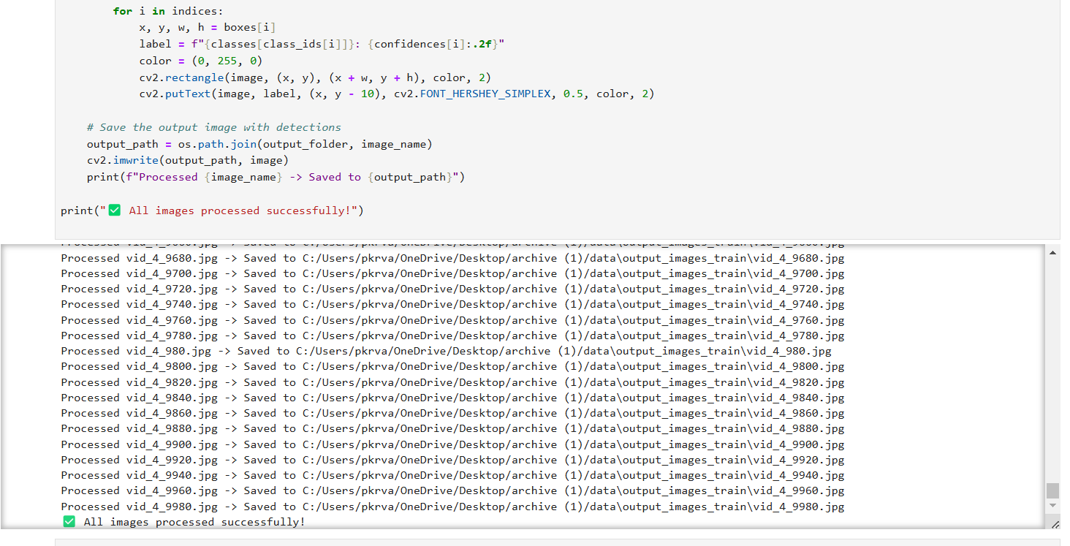
Result :

Slide 9
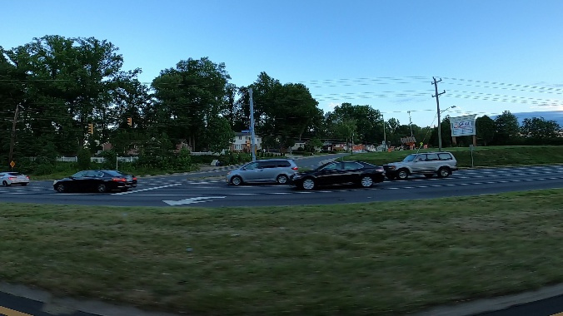
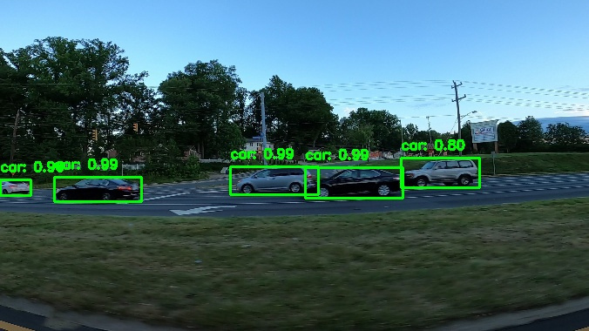
Before Detection :
After Detection :

Slide 10
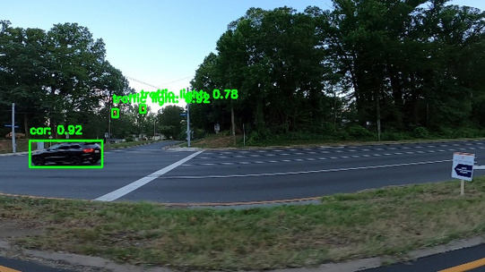
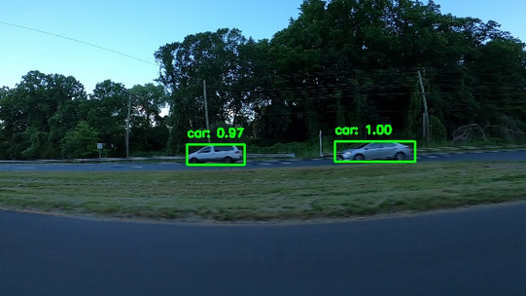
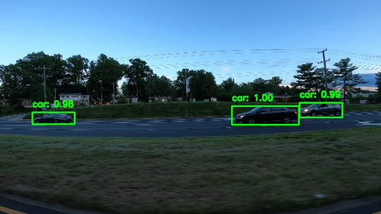

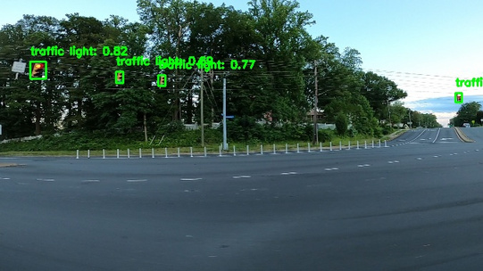
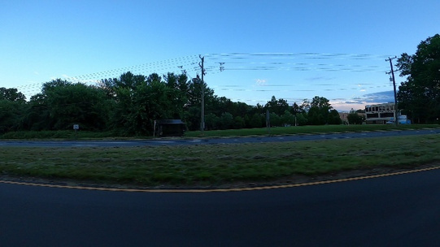
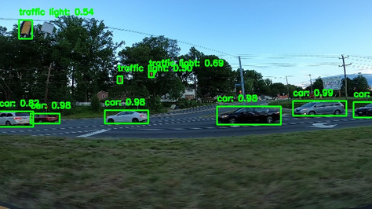
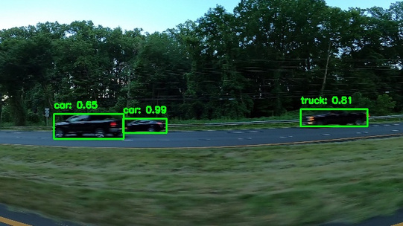
Outputs :

Slide 11
Project By :
K. Iniya - Cb.sc.u4aie24118
M.V Mukesh - Cb.sc.u4aie24138
P. Varshitha - Cb.sc.u4aie24144
U.V. Krishna Sudeepthi - Cb.sc.u4aie24165

Slide 12


